Slide 1
The financial value of percentage designation in Slovakia
Macro and micro perspective
Milan Andrejkovič

Slide 2
Macro perspective
Percentage mechanism in Slovakia in total numbers:
More than 15 years
Almost 550 mil. € designated in total
- Average* 36,6 mil.€/year

Slide 3
Macro perspective
Percentage mechanism in Slovakia in total numbers:
State budget spendings:
13600 mil. € in 2015 (without EU funds)
Total amount designed:
56 mil. € in 2015
Taxpayers decide directly about 0,4% of state budget spending

Slide 4
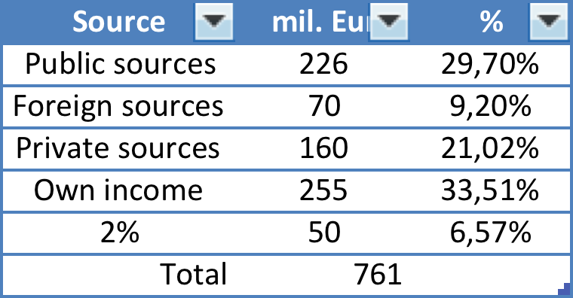
Macro perspective
Percentage mechanism in Slovakia in total numbers:

Slide 5
Macro perspective
Percentage mechanism in Slovakia in total numbers:

Slide 6
Micro perspective
Total number of recipients (NGOs) grows year by year:
Year | Number of organizations
2002 | 4034
2003 | 3398
2004 | 3829
2005 | 5746
2006 | 7100
2007 | 7662
2008 | 7720
2009 | 8993
2010 | 9585
2011 | 10052
2012 | 10962
2013 | 11236
2014 | 11908
2015 | 12577
2016 | 13410
* app. ¼ of all NGOs in Slovakia

Slide 7
Micro perspective
Total amount of € transfered:
Year | Total amount in 1000€
2002 | 3381,87
2003 | 3222,14
2004 | 27876,25
2005 | 30885,51
2006 | 37346,48
2007 | 42125,09
2008 | 49180,45
2009 | 55180,24
2010 | 44144,75
2011 | 41970
2012 | 44694
2013 | 46706
2014 | 52204,62
2015 | 56000*
* 2015 – higher than in 2009

Slide 8
Micro perspective
Average amount received by NGO:
Year | Average for 1 organization in €
2002 | 838
2003 | 948
2004 | 7280
2005 | 5375
2006 | 5260
2007 | 5498
2008 | 6371
2009 | 6136
2010 | 4606
2011 | 4175
2012 | 4077
2013 | 4157
2014 | 4384

Slide 9
Micro perspective
Extremes:
NGOs with 0€ - 100€ ...
(registration fee app. 75€)
NGOs (esp. foundations) with 1.000.000+ €

Slide 10
Micro perspective
Percentage of organization´s annual budget:
Highly individual:
Small sport, leisure time clubs, individual purpose organizations – up to 100% of budget
- highly vulnerable organizations
Professional NGOs with different income sources – could be less than 20% of budget
- multisource fundraising

